Slide 1
Troubleshooting Study
Summary
March 2022
Notes:
Maroya

Slide 2
Background
Notes:
Maroya

Slide 3
Background
Implement a plan to test a new design for the contacts section of ONRR.gov.
The current contacts section is not easy to navigate and does not allow users to find the correct ONRR employee with ease.
Notes:
Maroya

Slide 4
Goals
Notes:
Lindsay

Slide 5
Goals
Learn about any usability issues in the design.
Assess whether the new design is effective at facilitating users to complete their tasks from accessing the correct contact information.
Notes:
Lindsay

Slide 6
Overview
Notes:
Lindsay

Slide 7
Overview
18 people interviewed
Production & Royalty Reporter (P1, P5)
Revenue Reporter/Payor (P16)
Revenue Reporter (P18)
Royalty Reporter (P15)
BLM Production Reporter (P2, P6, P9, P13)
ONRR Customer Service Rep (P3, P4, P7, P10, P11, P14, P17)
STRAC Auditor (P8)
Inquisitor (P12)
Notes:
Lindsay

Slide 8
Prototype
Notes:
Lindsay

Slide 9
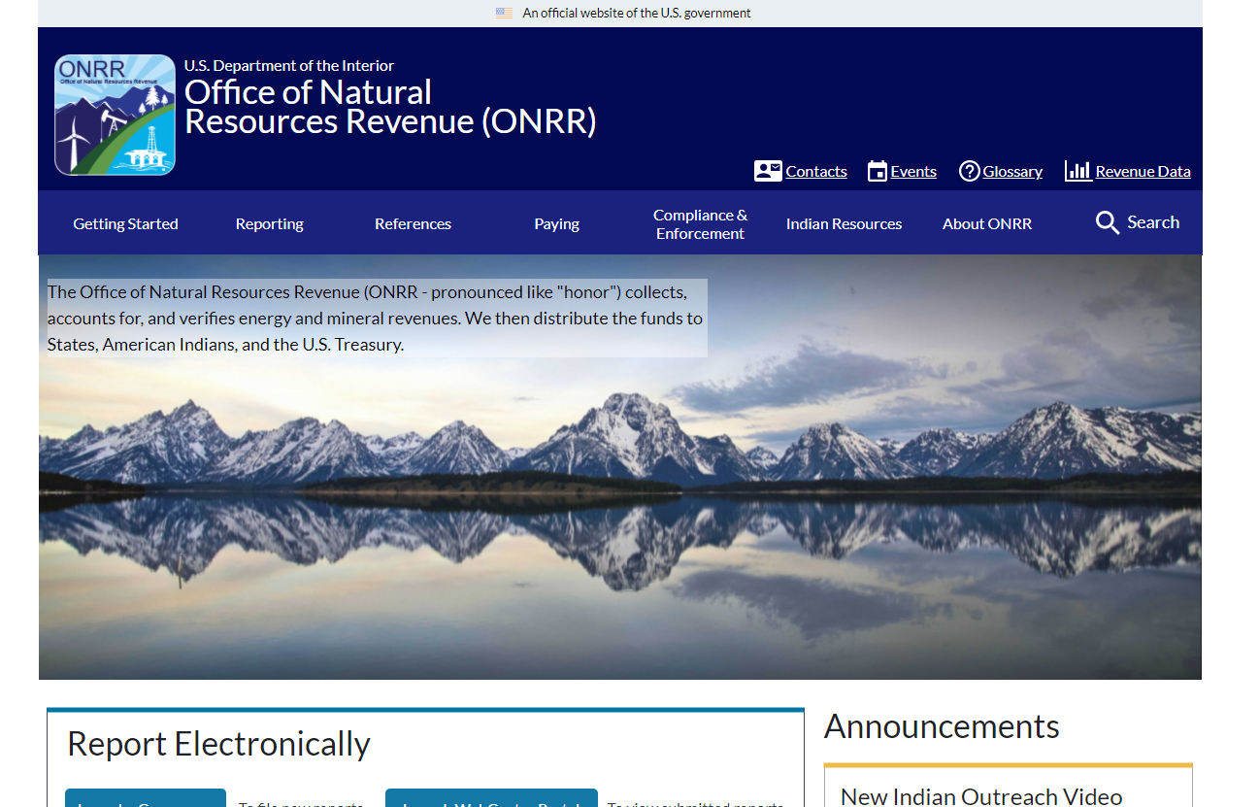
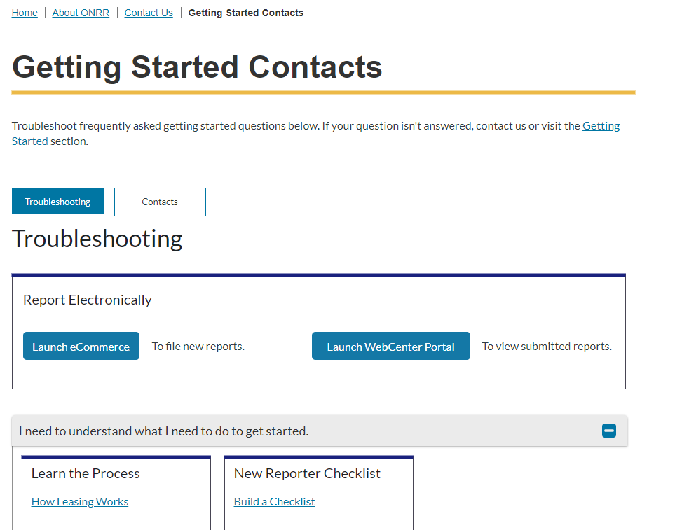
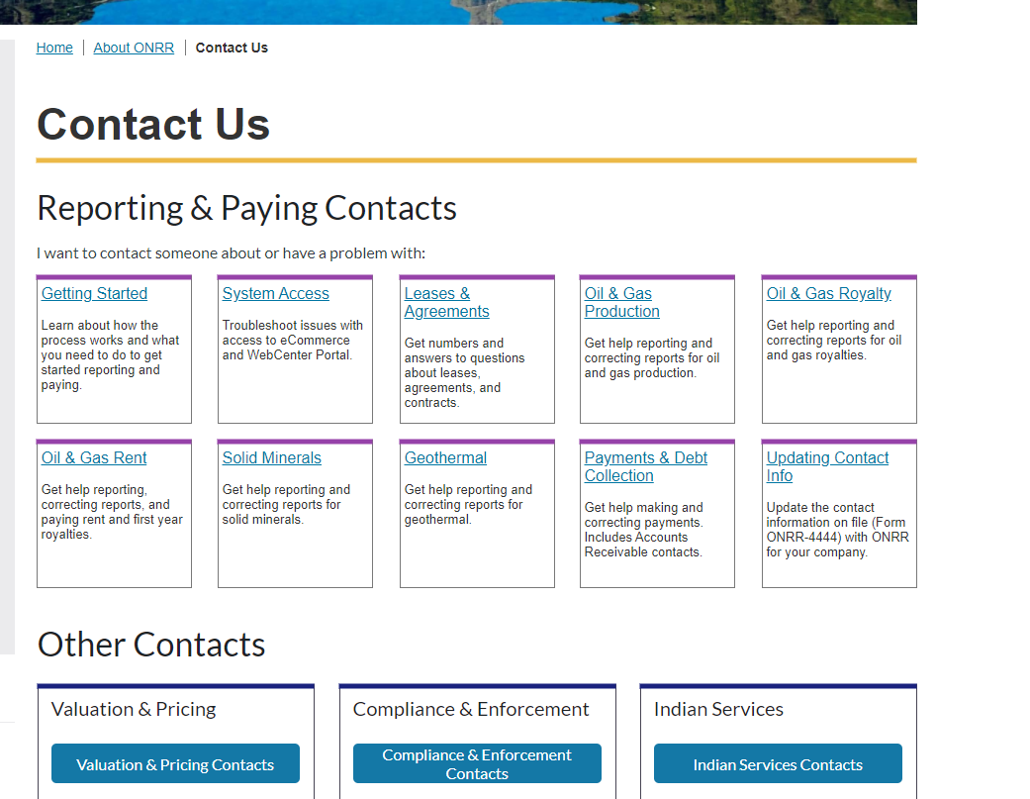
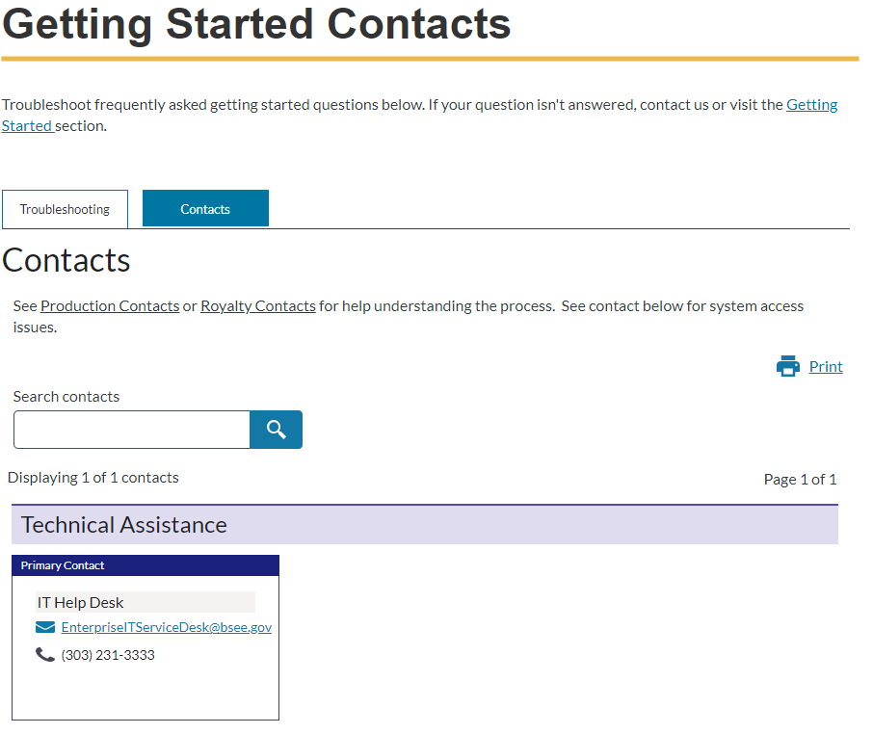
Notes:
Lindsay - elaborate on buy-in

Slide 10
Contacts
Positive feedback
Participants all need to contact ONRR customer service representatives and use the contact information on the current website. They contact through phone or email and some currently don't know who to contact with issues so have a go to person. The new card layout is well organized and has clear labeling of position titles. Some participants print the contact list.
Participants showed varying degrees of comfort level in navigating to the contacts page. The wayfinding solution as we currently have it is robust enough to accommodate different navigation styles -- i.e., search bar, contacts page, contacts embedded within each subpages, print and search.
Several participants explored and liked the new reporter checklists and shared they send similar information to new reporters.
Notes:
Lindsay

Slide 11
Contacts - Header
Findings Statement
The contact header was left without interaction by participants in the initial interviews.
Shannon made the changes from Contacts Us to Contacts, changed the icon from a phone handset to a person with a mail, and brought the Contact header closer to the top menu bar to increase visibility.
1 participant did not see the contacts link in header initially
Recommendation
Implement the improvements that were made mid interviews.
Severity: Medium
Complexity:
Status: Fixed, Github Issue #1709
Notes:
Lindsay

Slide 12
Contacts – Contacts by Company
Findings Statement - Navigation
Some participants suggested to change from company to operator, but others pointed out that keeping the term as is is more appropriate.
Some participants recommended A-Z link to avoid scrolling down and navigating between pages to arrive at the company of interest.
Recommendation
A-Z links were added and were noted by participants. Implement this design.
Severity: Low
Complexity:
Status: Design Updated, Github Issue #1512
Notes:
Lindsay

Slide 13
Contacts – Primary and Backup Contacts
Findings Statement – Differentiation between contact cards
Some participants didn't understand the primary-backup-supervisor color-coding in the initial prototype
Participants liked the highlighting of the primary-backup roles and found clear once design was updated.
Recommendation
This issues was addressed in an updated prototype. Implement this design.
Severity: Medium
Complexity:
Status: Design Updated, Github Issue #1393
Notes:
Lindsay

Slide 14
Contacts – Printing Contacts
Findings Statement – Print View
1 participant would like to see a print layout.
Recommendation
Review print layout
Severity: Low
Complexity: Low
Status:
Notes:
Lindsay

Slide 15
Contacts – Troubleshooting Location
Findings Statement –
1 participant would prefer to see the contacts first before the troubleshooting. 1 participant would prefer to see 'contacts' versus 'troubleshooting' as keyword for searching contacts.
Recommendation
Already addressed by adding clarification text to the top of the contacts tab section.
Severity: Medium
Complexity: Low
Status: Completed, Github issue #1708
Notes:
Lindsay

Slide 16
Contacts – Bugs
Findings Statement
1 participant noted that there are inaccuracies in the solids contacts
Recommendation
Review and correct the solids contacts.
Severity: High
Complexity: Low
Status: Fixed, Github #1744
Notes:
Lindsay

Slide 17
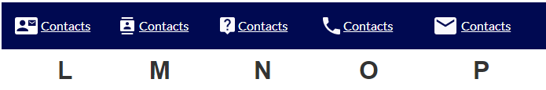
Contacts – Contact Icon
Option L was chosen as the ideal contact icon by participants
Severity: High
Complexity: Medium
Status: Fixed, Github Issue #1709
Notes:
Lindsay

Slide 18
References
Findings Statement
2 participants were confused by the words reference lists and codes when looking for lease and agreements or cross-references, but were able to find what was needed.
Recommendation
Continue to test and ensure that users are able to find needed references.
Severity: Medium
Complexity: Low
Status:
Notes:
Lindsay

Slide 19
References – Downloads
Findings Statement
3 participants wanted to download the cross references txt file in excel format
Recommendation
Add an option to download in excel format
Severity: High
Complexity: Low
Status: Issue create Github issue #1711
Notes:
Lindsay

Slide 20
Search Function
Findings Statement
Majority of participants wanted a search feature.
Recommendation
Have a robust search feature.
Severity: High
Complexity: High
Status: Issue created, Github #873
Notes:
Lindsay

Slide 21
New Reporter Checklists
Findings Statement
Several participants didn't notice the "next" button and used the +/- buttons instead.
Recommendation
Remove the next button
Severity: Low
Complexity: Low
Status: Completed, Github issue #1713
Notes:
Lindsay

Slide 22
New Reporter Checklists – Training Links
Findings Statement
Several participants want to make sure that training links are highlighted in the checklists.
Several participants wanted to make sure that links to training videos and reporter handbooks were added or highlighted in checklists.
Recommendation
Review and update appropriate links as needed.
Severity: High
Complexity: Low
Status:
Notes:
Lindsay

Slide 23
Reporter Training – ONRR Systems
Findings Statement
1 participant would like to have more info on MART and other systems.
Recommendation
Explore adding more information on ONRR systems
Severity: Low
Complexity: Low
Status:
Notes:
Lindsay

Slide 24
Reporter Training – BLM Resources
Findings Statement
1 participant creates own training resources
Recommendation
Reach out to BLM about adding the training material to the ONRR website
Severity: Low
Complexity: High
Status:
Notes:
Lindsay

Slide 25
Tabs
Findings Statement
First participants were confused by the tabs in the early prototype.
Participants using the more recent prototype found the tabs more intuitive.
Recommendation
Updated prototype fixed issues. Implement changes.
Severity: High
Complexity: Low
Status: Fixed, Github issue #1707
Notes:
Lindsay

Slide 26
Unpaid Debts – Update
Findings Statement
1 participant was on the Unpaid Debt webpage, and didn’t realize she was on the correct page. Suggests adding her as a contact here for treasury referrals. Shannon suggests linking the contacts collection, and she agreed that’s a good idea. Participants using the more recent prototype found the tabs more intuitive.
Recommendation
Link the contacts collection from the Unpaid Debt webpage
Severity: Low
Complexity: Low
Status: Fixed, Issue created Github issue #1745

